Slide 1
Why are most Filipinos hungry?

Slide 2
Invisible hunger

Slide 3
1M families
This is the official 2021 magnitude of hungry families (3.9%), but it is based on a threshold of only Php55 per person per day.

Slide 4
But others are saying more
SWS involuntary hunger
3M families (11.8%) were hungry and had nothing to eat in the past 3 months
SWS self-rated hunger
72% of families are food-poor or borderline food-poor

Slide 5
5.9% hungry
This is the official 2021 hunger incidence among population (6.5M), but it is based on only Php55-per-day threshold.

Slide 6
48.6% of population
5.7M Filipinos
1 of 10 families
Severely (5.3M) and moderately (48M) food insecure (FAO)
Undernourished 2019-2021 (FAO)
Food insecure (WFP)

Slide 7
(2019-2021, % of population) | Moderate or severe food insecurity
Cambodia | 65.1
Philippines | 48.6
Thailand | 44.3
Lao PDR | 40.1
Myanmar | 29.2
Malaysia | 21.7
Vietnam | 8.2
Indonesia | 6.7
Singapore | 5.3
Brunei | n.a.
PH households meeting 100% REI & EAR | %
Iron (mg) | 6.0
Calcium (g) | 12.0
Energy (kcal) | 22.0
Protein (g) | 55.0

Slide 8
Malnutrition among children, 5 years old and below
Underweight | 19.1%
Stunting | 30.3%
Wasting | 5.6%
Overweight | 4.0%

Slide 9
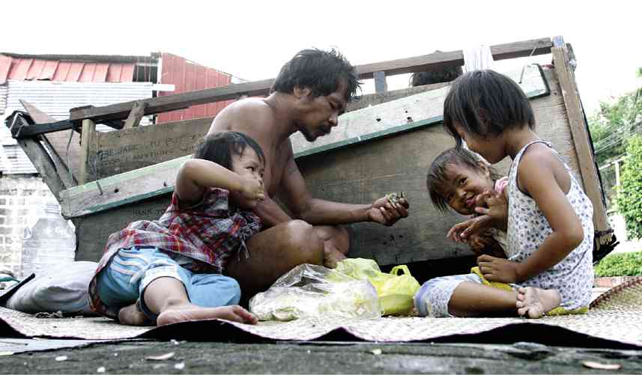
Malnutrition disproportionately affects the poor

Slide 10
Inflation made it worse

Slide 11
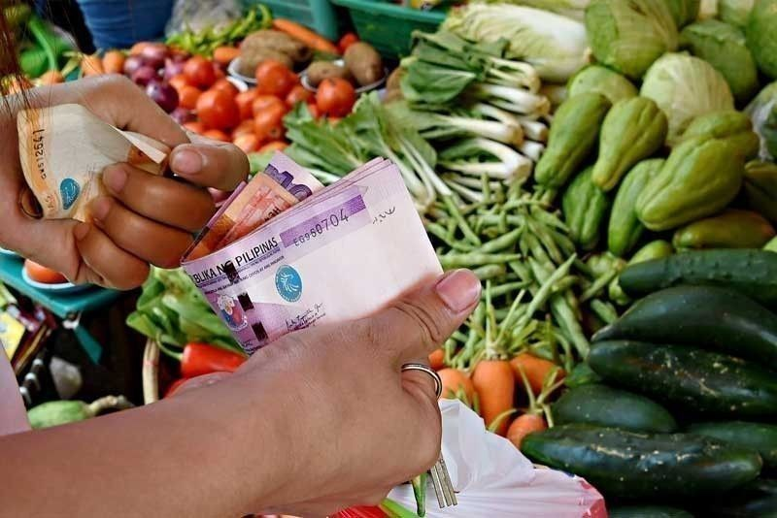
Worst inflation in 14 years
February 2023 inflation rate of 8.6%, pushed by 11.1% food inflation
Sugar, vegetables, corn, bread, cooking oil, and the golden onion
Transportation, oil, water, gas, electricity, and housing expenses

Slide 12
52% of family expenses go to food; higher percentage for poorest 50% of families

Slide 13
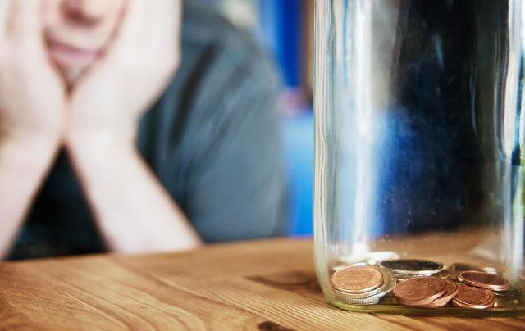
Historic decline in the real value of wages
The real value of the minimum wage of Php570 in NCR declined for the first time in history under Duterte’s time, from Php538 in June 2016 to Php508 in June 2022, then further to Php482 during the first 7 months of Marcos Jr.
This only means that wage increases had been infrequent and too small to cope with inflation.

Slide 14
68.6% (75.2M) Filipinos cannot afford a healthy diet

Slide 15
Neoliberalism has made most of us hungry

Slide 16
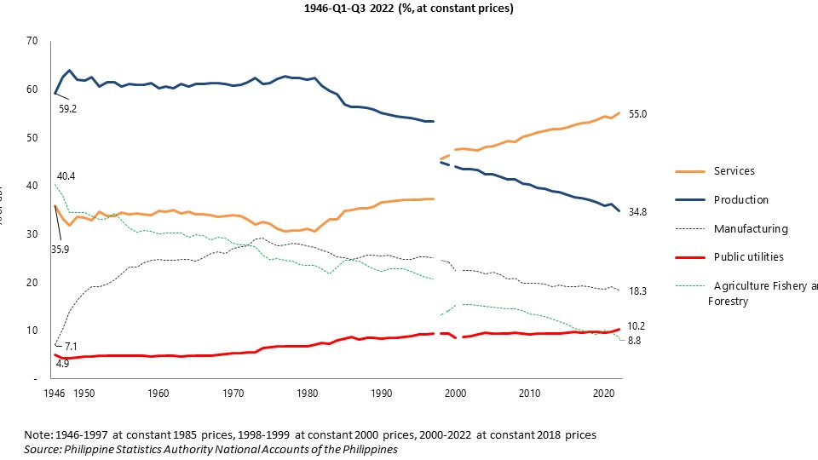
The structural roots of hunger: PH economic foundations at their weakest in 70+ years

Slide 17
Opening up economy to takeover by foreign capital (soaring foreign direct investment)
Source: UNCTAD

Slide 18
Falling priority for agriculture in budget
Falling agriculture in GDP, rising food prices
 | June 30, 2016 | May 2022 (Second phase)
Rice - special | 50 | 53
Rice - well-milled | 40 | 43
Pork (lean meat/kasim) | 180 | 326
Dressed chicken | 140 | 174
Bangus | 120 | 190
Galunggong | 140 | 233
Tilapia | 100 | 128
Eggplant (8-10 pcs/kg) | 40 | 70
Tomato (15-18 pcs/kg) | 40 | 97
White potato (10-12 pcs/kg) | 60 | 75
Red onion (13-15 pcs/kg) | 100 | 83
Lakatan | 60 | 64
White sugar | 54 | 68
Source: PSA

Slide 19
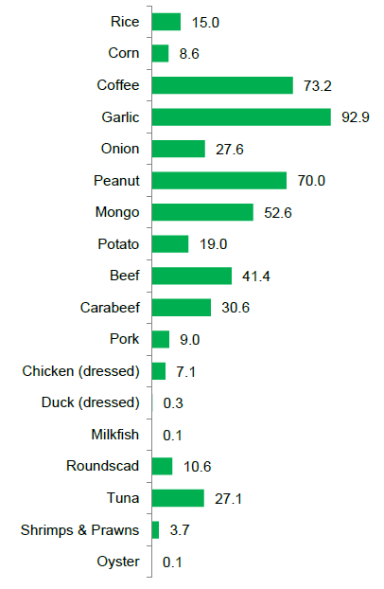
High food prices from agricultural decline, agricultural trade deficit & food import dependence
Import dependency ratio of selected agricultural commodities (%)
2010 2016
2020
18.7 | 4.9
1.4 | 10.0
45.3 | 68.1
71.8 | 89.1
7.8 | 52.6
69.9 | 72.5
53.6 | 47.9
4.8 | 14.8
20.5 | 32.7
31.8 | 31.5
 | 10.6
10.2 | 15.5
0.7 | 0.9
0.01 | -
0.1 | 0.4
4.0 | 21.2
3.3 | 5.7
0.1 | 0.02
Source: PSA

Slide 20
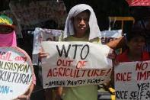
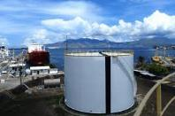
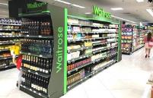
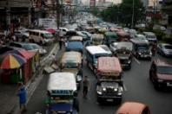
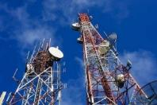
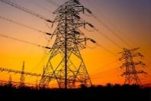
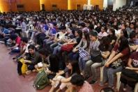
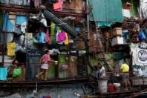
Prices are higher than they should be because of: 1) state-supported profit-seeking; and 2) high consumption taxes
PRIVATE PROFIT-SEEKING PROVISION OF GOODS & SERVICES
REGRESSIVE CONSUMPTION TAXES
Import-dependence
consumer goods, intermediate, producer
Excise tax & VAT UP
Corporate tax DOWN
Privatized utilities
transport, telecoms, power, water
Individual tax UP
Privatized social services
education, health, housing
NO billionaire wealth tax
NO windfall tax on private land values rising from public infra projects
NO billionaire wealth tax
NO windfall tax on private land values rising from public infra projects
Photo credits: PUP, CNN, Reuters, NY Times, PhilStar, GMA News, Rappler, HKTDC

Slide 21
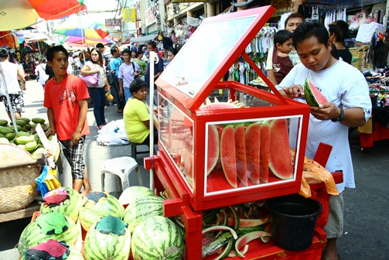
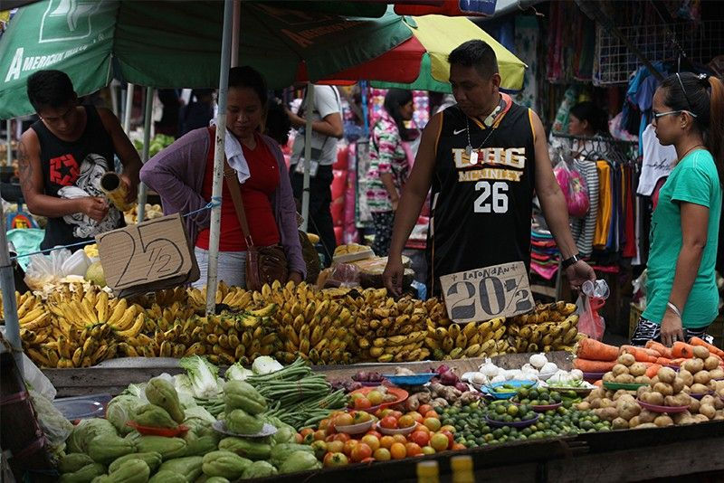
Unprecedented and massive but disguised jobs crisis
Lack of jobs is widespread; PH is #1 in unemployment in Southeast Asia
Of the 100 ‘employed’, 74 are in informal work
Informal work ballooned from 29.3 million (2019) to 32.8 million (2022)
In Marcos Jr’s first 6 months, of the 10 reported jobs created, 8 are just part-time work
In the last two decades, the economy has created less and less jobs

Slide 22
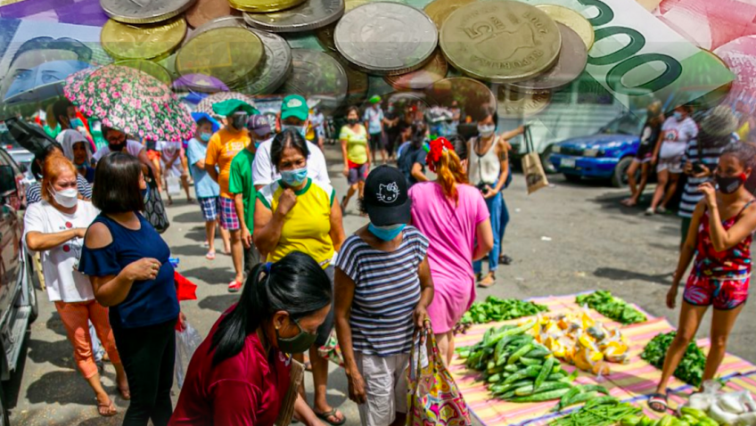
Worsening but invisible poverty
Poverty incidence increased in 2021 (13.2%); 20M Filipinos (18.1% of population), but this is based on the low official threshold of Php79 per day
PH is 4th worst poverty in Southeast Asia (ADB)

Slide 23
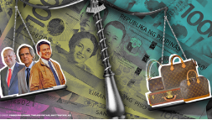
Severe inequality
There is a huge gap between rich and poor. The median wealth is only Php140,000.
0.1% of all families have income of Php350K-Php10M per month, while 60% of us have income of only Php22,000 or less per month
Net income of 50 richest Filipinos is equal to the net income of 60-70M population
The net income of the 10 richest even increased 81% in 2021, while real wages declined
In 100 countries, the highest increase in inequality happened in PH (World Bank)

Slide 24
The govt can do a lot of things to solve our economic troubles, but it simply chooses not to.
It chooses not to control prices.
It chooses not to confront monopoly traders and smugglers.
It chooses not to stop importation and increase local production.
It chooses not to tax corporations, the rich and billionaires.
It chooses not to strengthen progressive taxation.
It chooses not to expand social services and protection.
It chooses not to increase wages.
It chooses not to protect and develop the national economy.

Slide 25
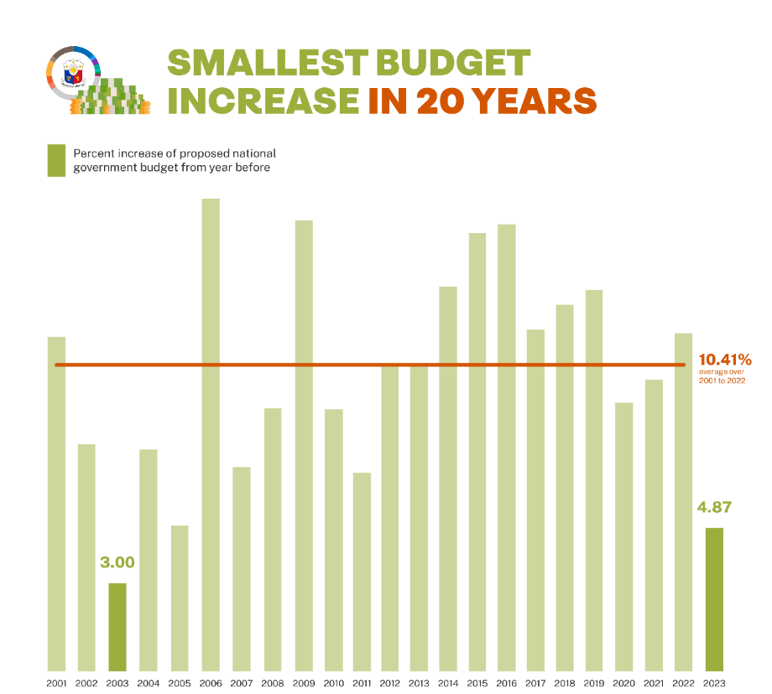
Instead, in the face of our mounting problems, we are entering a period of austerity.
Budget for ayuda is cut.
Additional budgets for social services are small, while there is Php338.3B increase in debt service.
Budget for militarism is even higher than budgets for health, labor, agriculture, and social welfare.
Budget for the Office of the Vice-President even got a huge Php1.5B increase.

Slide 26
Austerity means less social services, more debt and more taxes on the poor and middle class.
National debt increased during the pandemic, but only 22% really went to COVID in 2020-2021.
Gross borrowings for 2023 will be Php2.2T, but Php1.6T is for debt servicing.
Govt also borrows for corruption-laden infra projects and to pay for debt, in short to support big business.
The irony: social and protection services are shrinking but taxes on the poor and middle class are increasing.

Slide 27
Instead, the Marcos Jr admin presents a development plan that remains in the disastrous neoliberal framework.
We must give our best to stop this and truly eradicate hunger.

Slide 28

Thank you!
IBON Foundation
March 18, 2023

